Slide 1
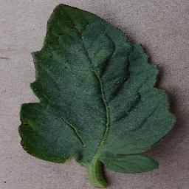
Predicting the Health of a
Tomato Crop
Team -03
G.Chandana – 17K41A0536
M.Nikhitha – 17K41A0545
S.Hima Sree – 17K41A05B6

Slide 2
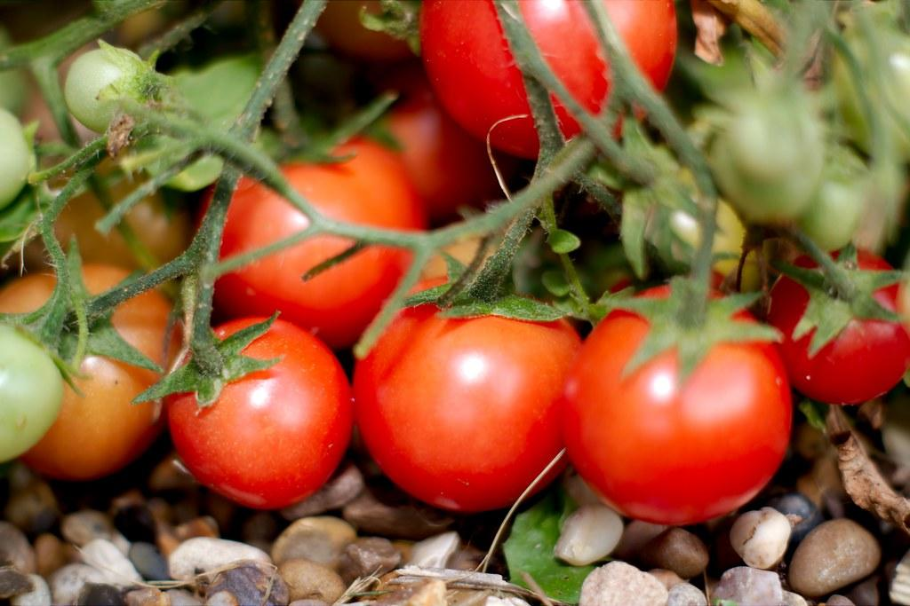
INTRODUCTION
India is a global agricultural powerhouse. It is the second largest producer of rice, wheat,vegetables and tea etc.Tomato is the most common vegetable used in India.It is grown across various places in India and consumed by many people. Tomato crop cultivation area in India spans around 3,50,000 hectares approximately and the production quantities roughly sum up to 53,00,000 tons, making India the third largest tomato producer in the world.

Slide 3
PROBLEM STATEMENT
Identifying the condition of tomato crop which is infected or not.
To get high yield and healthy food, farmers must make sure that they grow it properly.It is important to identify the infected crops ao as one can prevent the spreading of disease to the healthy growing crops.

Slide 4
OBJECTIVES
To determine whether the plant is healthy or not.
Describing the type of the disease caused to the plant.
Making the application user friendly.

Slide 5
EXISTING WORKS
Existing works provide solution to classify only five types of diseases occured in a crop and also they don’t classify between infected and non infected plants.
This may lead to bias as healthy crop might fall into one of the infected ones.
We want to advance it by categorising into 10 classifiers including the healthy crop.

Slide 6
DATASET
Dataset is taken from kaggle.
Image size (256,256)
Tomato_Septoria_leaf_spot
Tomato_Early_blight
Tomato_Late_blight
Tomato_healthy

Slide 7
Tomato__Tomato_YellowLeaf__Curl_Virus
Tomato_Spider_mites_Two_spotted_spider_mite
Tomato_Leaf_Mold
Tomato__Target_Spot
Tomato__Tomato_mosaic_virus
Tomato_Bacterial_spot

Slide 8
TECHNOLOGY
Convolutional neural networks
Lenet Architecture.

Slide 9
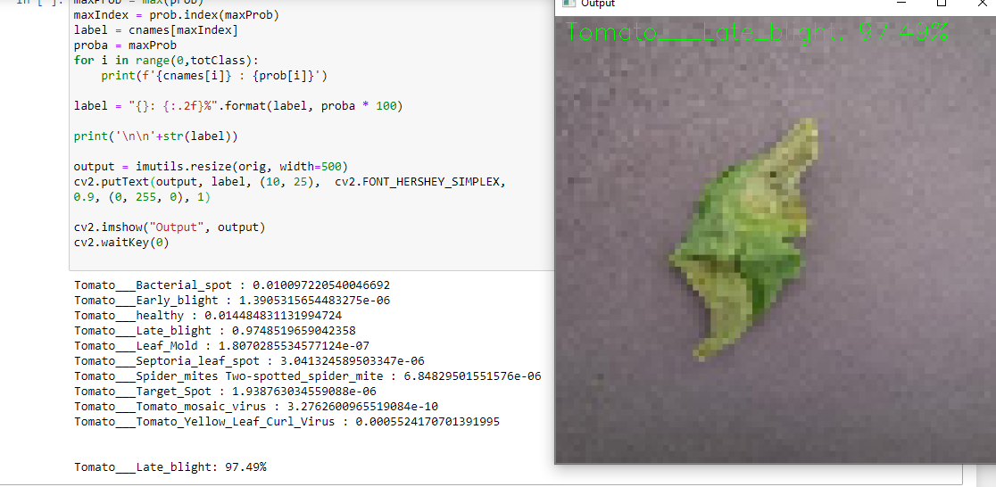
RESULTS :

Slide 10
THANK YOU

